Slide 1
A gentle intro to Cosmos DB for the ASP.NET and SQL Server developer
Santosh Hari

Slide 2
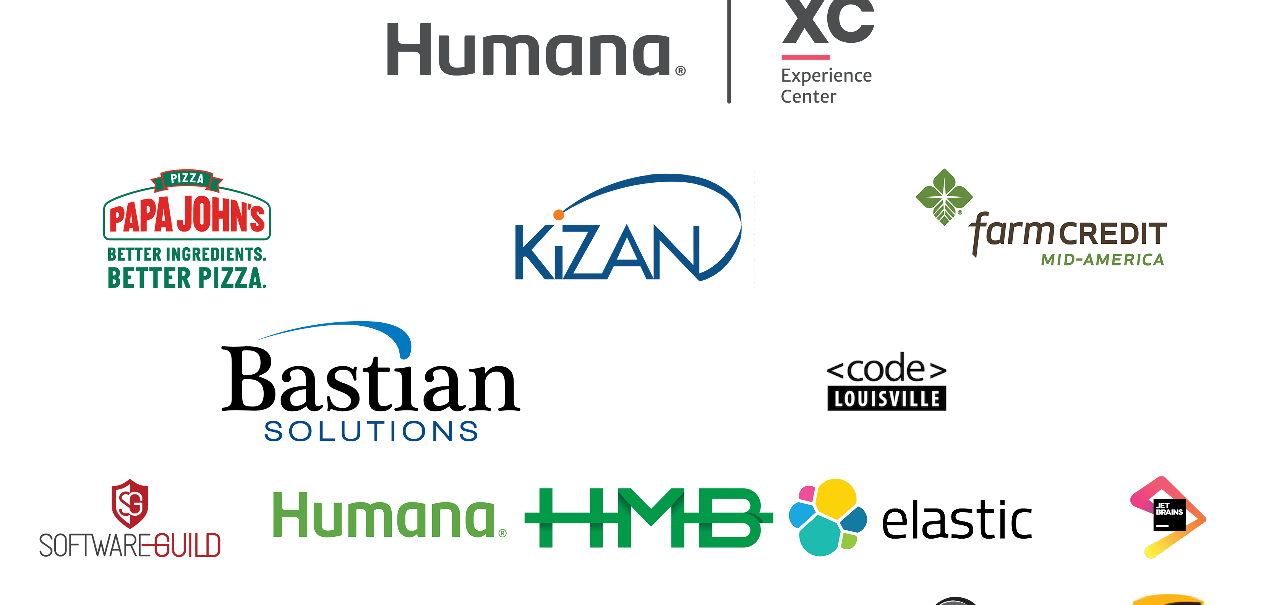

Slide 3



Santosh Hari
Azure Consultant @ Nebbia Tech
Azure MVP
President, Orlando .NET UG
Organizer, Orlando Codecamp
santoshhari.wordpress.com
santosh@nebbiatech.com
@_s_hari
/in/santoshhari

Slide 4
Agenda
Start with a demo of the SQL API
Walk through demo output and discuss features
Discuss multi-model and polyglot persistence
The only silly questions are the ones you don’t ask
Address legitimate question and concerns
Focus on value not cost

Slide 5
With great power, comes great responsibility
Abraham Lincoln … or …. Spiderman movie?

Slide 6

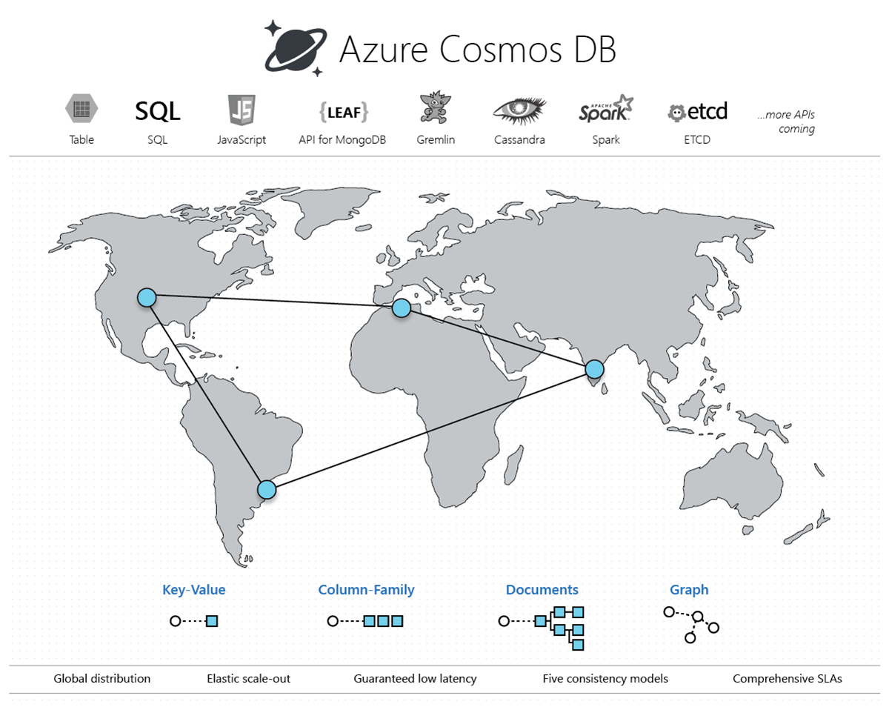
Notes:
Azure Cosmos DB is Microsoft’s database-as-a-service
globally distributed,
multi-model NoSQL - SQL, MongoDB, Cassandra, Tables, or Gremlin
elastically scale throughput and storage across Azure regions worldwide with a click of a button
fast, single-digit-millisecond data access

Slide 7
DEMO

Slide 8
TALK ABOUT FEATURES BASED ON DEMO OUTPUT

Slide 9
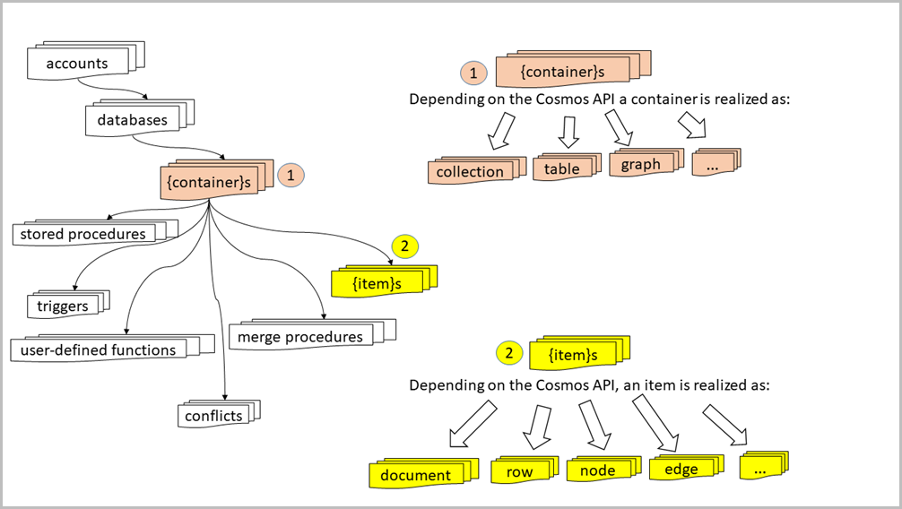
Notes:
A database account consists of a set of databases, each containing multiple collections, each of which can contain stored procedures, triggers, UDFs, documents/graphs/tables/keyspaces. A database also has associated users, each with a set of permissions to access various other collections, stored procedures, triggers, UDFs, documents, or attachments. While databases, users, permissions, and collections are system-defined resources with well-known schemas - documents, stored procedures, triggers, UDFs, and attachments contain arbitrary, user defined JSON content.

Slide 10
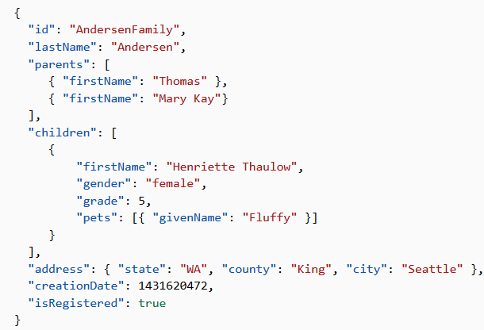

LINQ-style queries

Slide 11
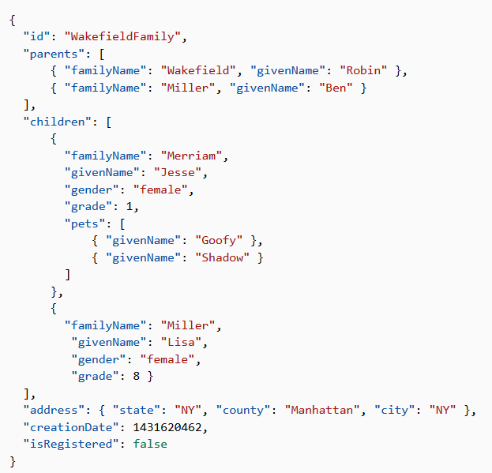
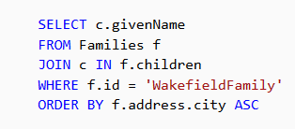
LINQ-style queries

Slide 12
Schema-agnostic, auto index management
Schema-agnostic
Automatic Indexing
No secondary indices
Two modes: Consistent and None
Include/exclude paths
Index types: Range and spatial
Composite indices for ORDER BY multiple
TTL
Notes:
Automatic and synchronous indexing of all ingested content
- hash, range, geo-spatial, and columnar
No schemas or secondary indices ever needed
Resource governed, write optimized database engine with latch free and log structured techniques
Online and in-situ index transformations
While the database is fully schema-agnostic, schema-extraction is built in
Customers can get Avro schemas from the database

Slide 13
Elastically Scaling of Storage and Throughput
Scale across multiple regions
Handle volume requests
Handle unpredictable bursts
Horizontal scaling impacts consistency
Storage to throughput ratio impacts use cases
Throughput provisioned beforehand
Storage (hypothetically) unlimited
Notes:
Independently and elastically scale storage and throughput across regions –
even during unpredictable traffic bursts
Elastic Scale out -> Tunable Consistency
Small storage – large throughput (e.g. notification broadcast/poll)
Large storage – small throughput (e.g. classic data/log store)

Slide 14
Low latencies guaranteed
Single digit millisecond latencies
Read-writes 99th percentile
Same region only
Requires careful DB design
Notes:
guarantees less than 10-ms latencies for both, reads (indexed) and writes at the 99th percentile
enables sustained ingestion of data and blazing-fast queries for highly responsive apps

Slide 15
Turnkey Global Distribution
Ring Zero service
Replicate with click of a button
Failover – manual and automatic
Default single master region for writes
Multi-master write also available
More regions impacts consistency
Multi-master double the cost of single

Slide 16
5 consistency models
Strong
Bounded-staleness
Session
Consistent prefix
Eventual
Notes:
No red pill-blue pill type choices
5 well-defined consistency models
Performance-consistency tradeoffs
Strong consistency single region only
Bounded staleness – if you write and then read, within the staleness window of K versions of data and T amount of time
When in doubt, pick session. Session strongly consistent in same session, eventual consistency outside of session
Consistent-prefix – similar to bounded staleness, no minimum guarantee for time and versions
Eventual – No order guarantee

Slide 17
Security and Compliance
Encrypted at rest and in motion
Encryption is default
Everything is encrypted
Zero impact on performance
Transparent
Compliance: ISO, blah blah

Slide 18
MULTI-MODEL

Slide 19


Multiple Data Models and API’s
Use the model that fits your requirements, and the apis, tools, and frameworks you prefer
MongoDB
Table API
SQL
Column-family
Document
Key-value
Graph
Notes:
Cosmos DB offers a multitude of APIs to access and query data including,
SQL, various popular OSS APIs, and native support for NoSQL workloads.
Use key-value, columnar, graph, and document data
Data is automatically indexed, with no schema or secondary indexes required
Blazing fast queries with no lag
Multi – Model -> Elastic Scale out
No need to convert you data to meet any particular model

Slide 20
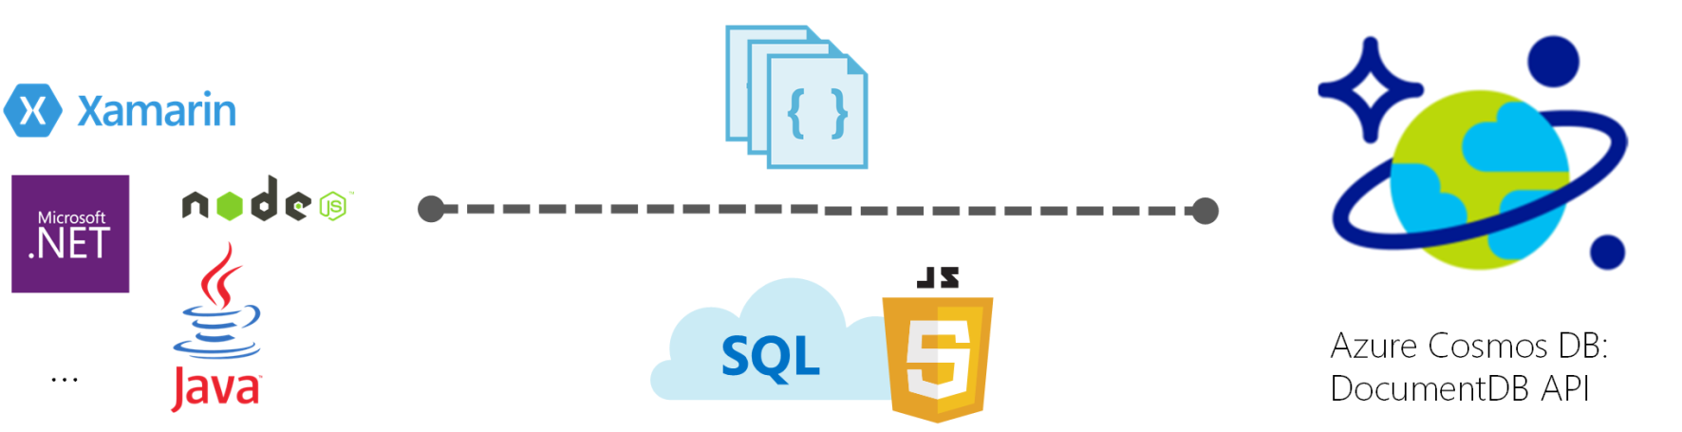
1. SQL API
Document Oriented NoSQL database
Schema-less JSON data
SQL query capabilities
Notes:
With the DocumentDB API, Azure Cosmos DB provides rich and familiar SQL query capabilities with consistent low latencies over schema-less JSON data. In this article, we provide an overview of the Azure Cosmos DB's DocumentDB API, and how you can use it to store massive volumes of JSON data, query them within order of milliseconds latency, and evolve the schema easily.

Slide 21
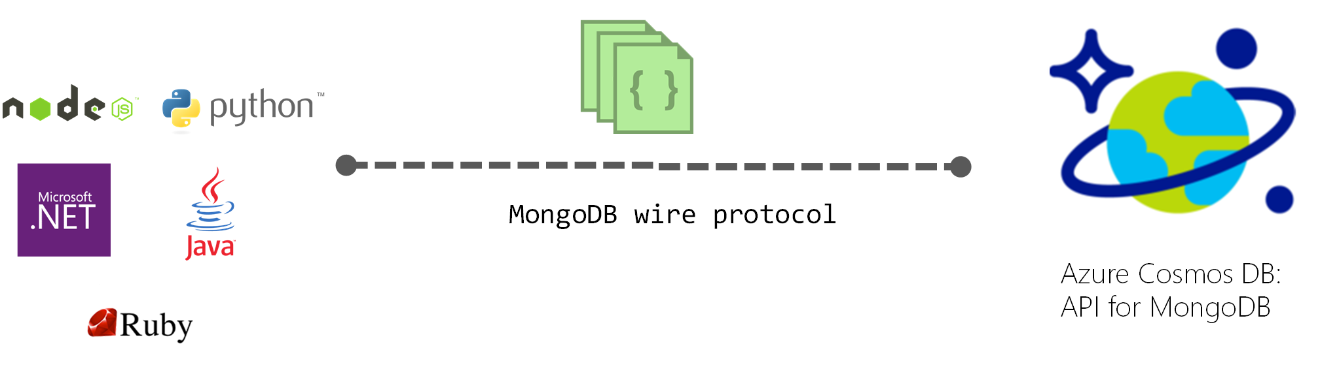
2. MongoDB
Document Oriented NoSQL database
Notes:
Cosmos DB databases can be used as the data store for apps written for MongoDB. This means that by using existing drivers, your application written for MongoDB can now communicate with Cosmos DB and use Cosmos DB databases instead of MongoDB databases. In many cases, you can switch from using MongoDB to Cosmos DB by simply changing a connection string. Using this functionality, you can easily build and run MongoDB database applications in the Azure cloud with Azure Cosmos DB's global distribution and comprehensive industry leading SLAs, while continuing to use familiar skills and tools for MongoDB.

Slide 22
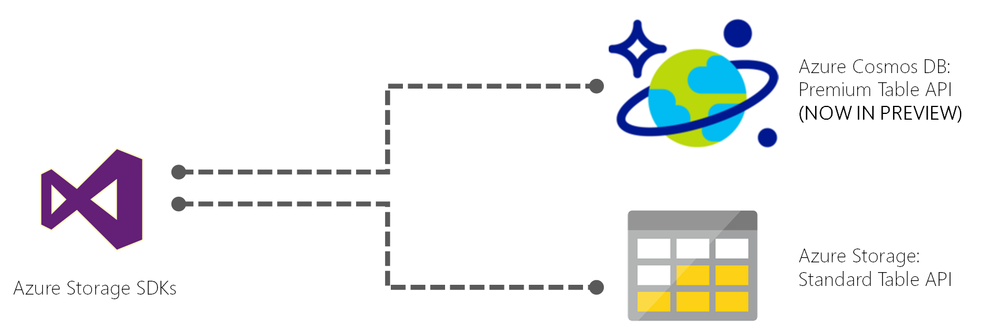
3. Table Storage
Key-Value NoSQL storage
Same as Azure Table Storage but premium
In Preview currently!!
Notes:
Azure Cosmos DB provides the Table API for applications that need a key-value store with flexible schema. Azure Table storage SDKs and REST APIs can be used to work with Azure Cosmos DB. You can use Azure Cosmos DB to create tables with high throughput requirements. Azure Cosmos DB supports throughput-optimized tables (informally called "premium tables")
You can continue to use Azure Table storage for tables with high storage and lower throughput requirements.
Azure Cosmos DB will introduce support for storage-optimized tables in a future update, and existing and new Azure Table storage accounts will be upgraded to Azure Cosmos DB.

Slide 23
3. Table Storage
Pros:
Simple queries
Simple data-modeling
Cons:
Bad for returning large datasets.
Bad at relational data
Bad at aggregation.
Notes:
Pro: Supports simple queries very efficiently. Very simple data-modeling pattern, should be understandable by anyone.
Con: The only queries that are efficient are simple, one-row-at-a-time queries.
Not really a data model at all, in that there's no association between attributes that form an entity.
Hard to use most ordinary SQL operations such as JOIN or GROUP BY.
You can't choose an appropriate SQL data type for the value.
You can't use many SQL constraints such as FOREIGN KEY or NOT NULL.
Pivoting the result to resemble a conventional result (one column per attribute) is a complex and expensive query.
You have to write a lot more application code to reassemble collections of key/value pairs into objects.

Slide 24
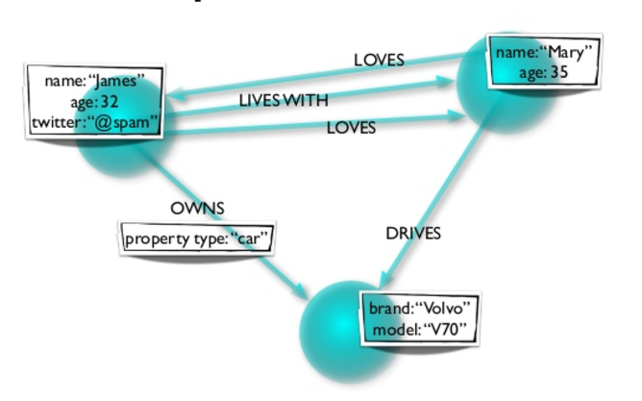
4. Graph (Gremlin)
Notes:
Data as it appears in the real world is naturally connected. Traditional data modeling focuses on entities. But for many applications, there is also a need to model the rich relationships between entities. Graphs allow you to model both entities and relationships naturally.
A graph is a structure composed of vertices and edges. Both vertices and edges can have an arbitrary number of properties. Vertices denote discrete objects such as a person, a place, or an event. Edges denote relationships between vertices. For instance, a person may know another person, have been involved in an event, and/or was recently at a particular place. Properties express information about the vertices and edges. Example properties include a vertex having a name, an age, and an edge having a timestamp and/or a weight. More formally, this model is known as a property graph. Azure Cosmos DB supports the property graph model.

Slide 25
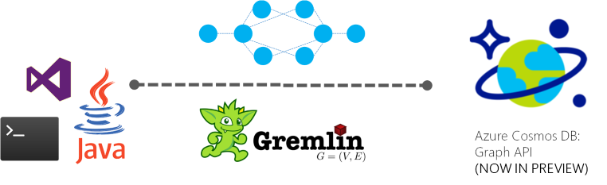
Graph (Gremlin)
Graph computing framework – Apache Tinkerpop
Graph traversal language – Gremlin
Super relational
Notes:
Azure Cosmos DB provides graph modeling and traversal APIs along with turn-key global distribution, elastic scaling of storage and throughput, <10 ms read latencies and <15 ms at p99, automatic indexing and query, tunable consistency levels, and comprehensive SLAs including 99.99% availability. Azure Cosmos DB can be queried using Apache TinkerPop's graph traversal language, Gremlin, and integrates with other TinkerPop-compatible graph systems like Apache Spark GraphX.

Slide 26
4. Graph (Gremlin)
Pro: Fast relationship queries
Pro: Fast to traverse nodes
Pro: Multiple dimensions
Con: Bad in transactions
Con: Bad at aggregation
Notes:
PROS
really fast queries when you are looking for relationships between nodes
Fast to traverse nodes
Can represent multiple dimensions
CONS
Inappropriate for transactional information, like accounting records where relationships between records are simpler
Harder to do summing queries and max queries efficiently - counting queries not harder
Usually need to learn a new query language like Gremlin
Fewer vendors to choose from, and smaller user base, so harder to get support when you run into issues

Slide 27
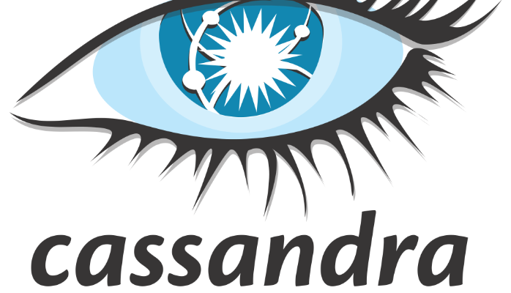
5. Cassandra
Column Oriented Database
Clusters by columns instead of rows
Notes:
By grouping columns together you can often load entire set of columns in memory for super fast calculations
Partition using logical partition keys
Best for range based calculations
Great use case is time series data like web analytics

Slide 28
Comprehensive SLA’s
Run your app on world-class infrastructure.
Azure Cosmos DB is the only service with financially-backed SLAs for millisecond latency at the 99th percentile, 99.999% HA and guaranteed throughput and consistency
Latency
HA
Throughput
Consistency
<10 ms
99.999%
Guaranteed
Guaranteed
99th percentile
Notes:
HA 99.999% for multi-region read; 99.99% for single region deployments

Slide 29
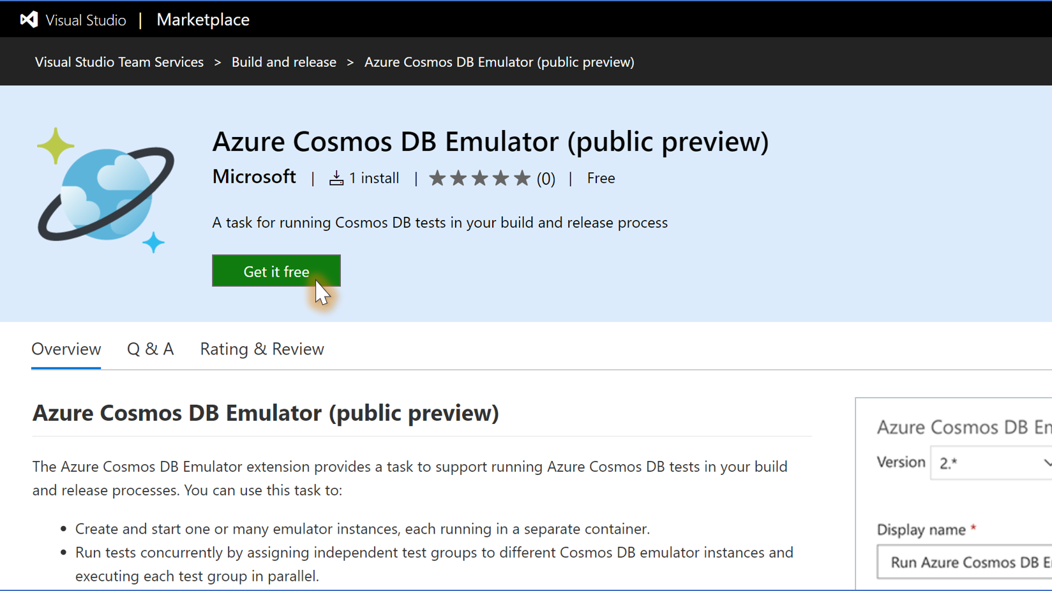
DevOps

Slide 30
Closing thoughts – going back to the whys
Get started right away on CosmosDB
Read up on basics and do it right
Polyglot data persistence
Shift focus from thinking of cost to thinking of value

Slide 31
Santosh Hari
Azure Consultant @ Nebbia Tech
Azure MVP
President, Orlando .NET UG
Organizer, Orlando Codecamp
santoshhari.wordpress.com
santosh@nebbiatech.com
@_s_hari
/in/santoshhari

